Slide 1
ENGOP
FPGA controlled robotic arm
Team member: Xiang Gong
Hao Wu
Zhenyang Wu
Ying Shi

Slide 2
Goal/Motivation
Designed an programable robotic arm and use keyboard and FPGA to control its movement.
Use example: Factory can use this robotic arm to move things in assemble line.

Slide 3
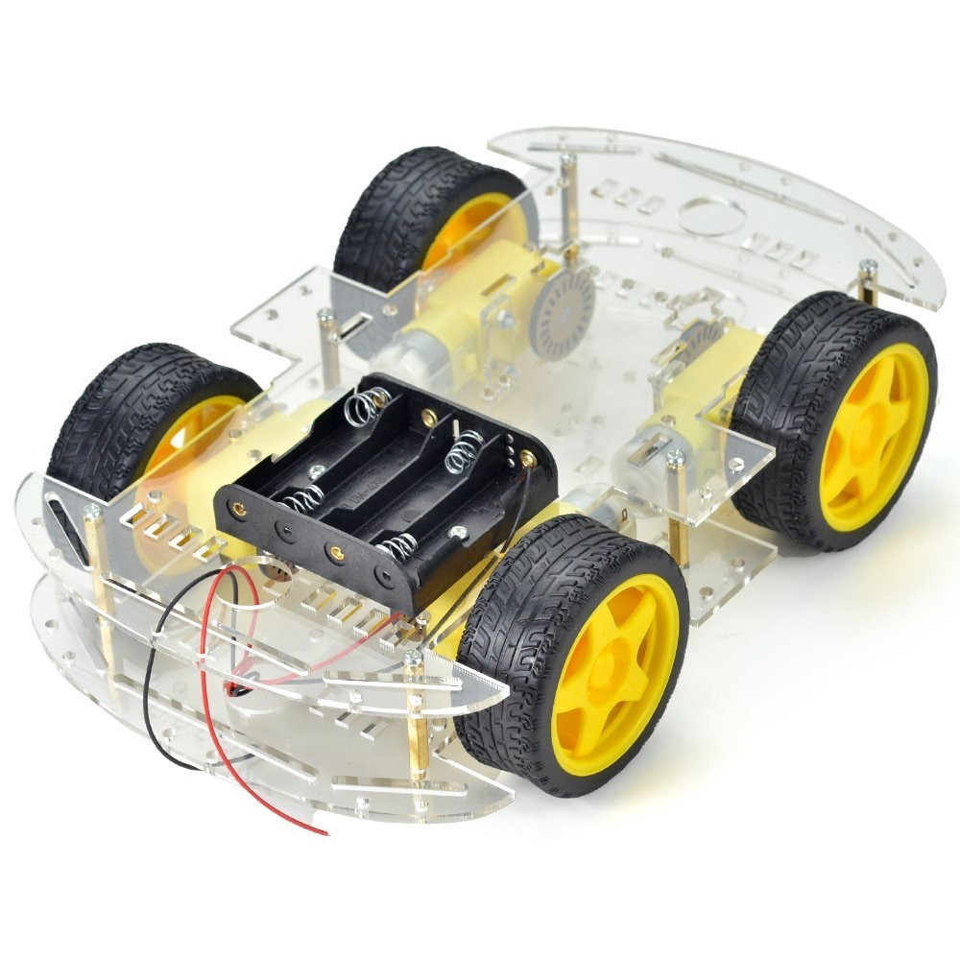
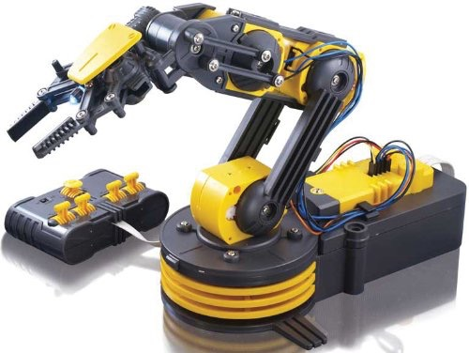
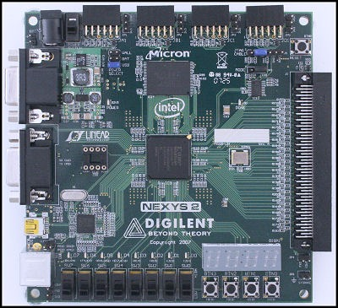
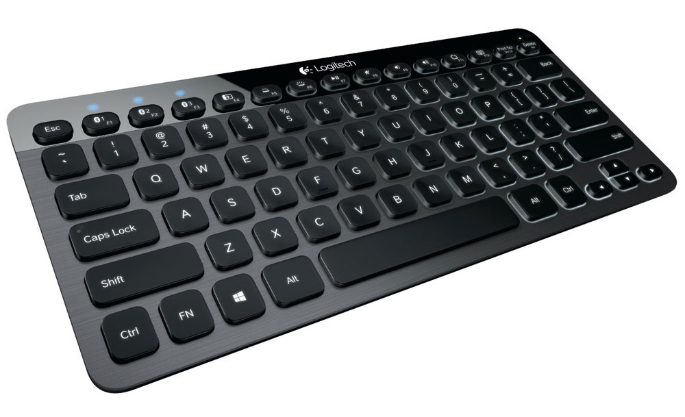
Short Specification
Hardware requirement:
robotic arm
FPGA
keyboard
kart
Basic Functionalities:
keyboard send control signal
controller decode control signal and choose mode
Send motor control signal to driver circuit
circuit drive motors

Slide 4
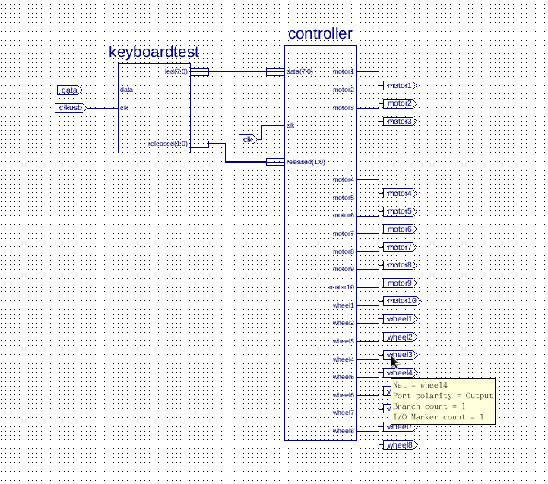
Short Functionality
Three modes:
Manual control mode
Record mode
Auto mode

Slide 5
Detailed Functionality
Five parts:
Keyboard
Manual mode
Record mode
Auto mode
Driver circuit

Slide 6
Detailed Functionality
Manual mode: When one keyboard button is pressed, the FPGA can deal with the corresponding signal and control the movement of the motors correctly.
Record mode: When entering the record mode, the FPGA can record the movement of the device in twenty seconds.
Auto mode: In this mode, when the auto button is pressed, the device can move with the way that we recorded.

Slide 7
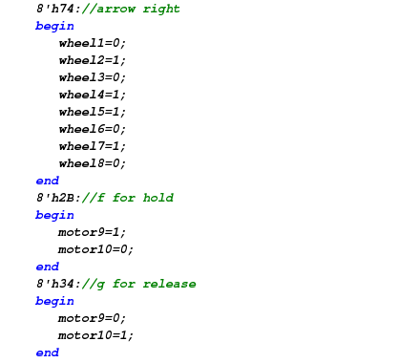
Manual Mode
When ‘Y’ is pressed, it will enter the manual mode.
The movement of robotic arm can be controlled by the user command.
By pressing different buttons, different motors could be activated by the signal from PMOD.
The memory is cleared at the beginning of this mode by setting the flag as 0.

Slide 8
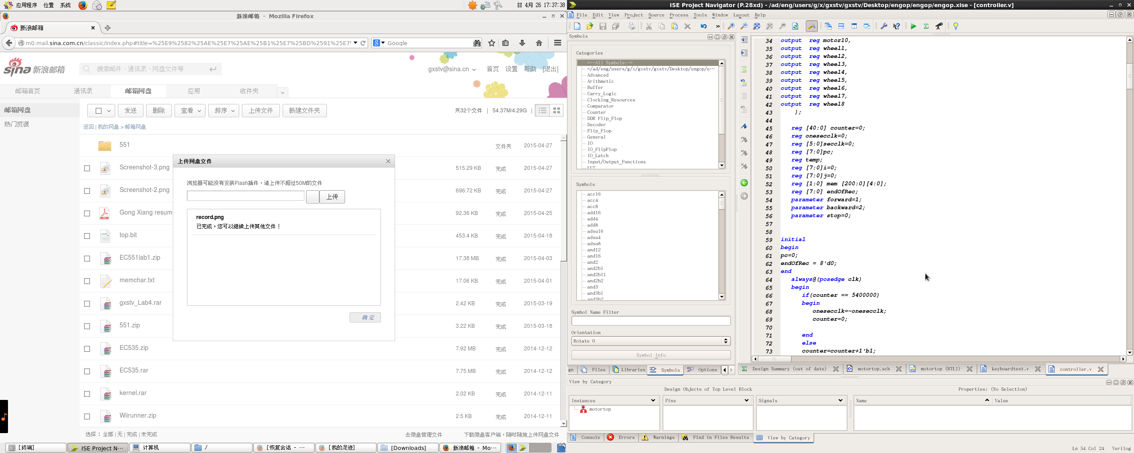
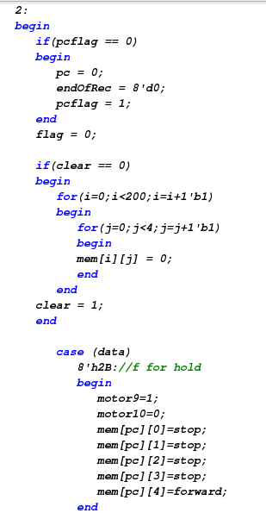
Record Mode
When ‘T’ is pressed, it will enter the record mode.
The FPGA will record user’s commands and store them in the memory.
The memory is a 3-dimensions array.
First dimension represents time and each element lasts 0.2 second long.
Second dimension represents motor number.
Third dimension represents motors’ state: 0 for stop, 1 for forward and 2 for backward.

Slide 9
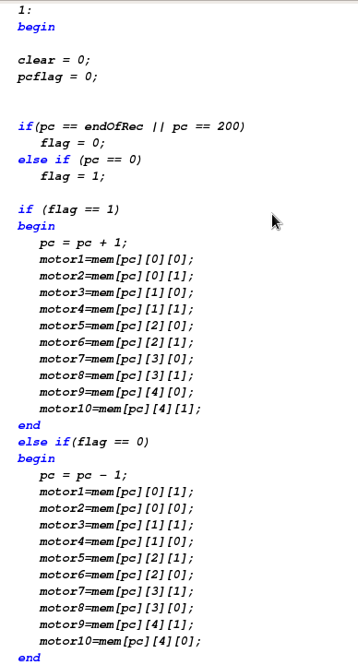
Auto mode
When ‘R’ is pressed, it will enter the auto mode.
The robotic arm will move automatically with the way it was recorded in the memory.
When the flag is set as ‘1’, the memory will be read backward to the location 0.
when the flag is set as ‘0’, the memory will be read forward to the last location written in the record mode.
By doing this, we can make sure it form a loop to repeat.

Slide 10
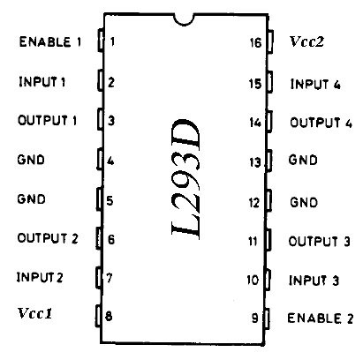
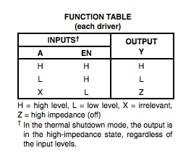
L293D chip
L293D chip:
high current half-H drivers

Slide 11
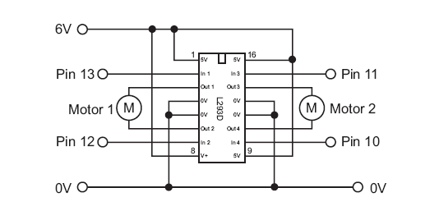
How to connect to motors
The motors are connected to the chip as showed in the figure.
Each chip can only control two motors, so at least 5 chips are needed. (9 motors in total, 5 in robotic arms and 4 in kart)

Slide 12
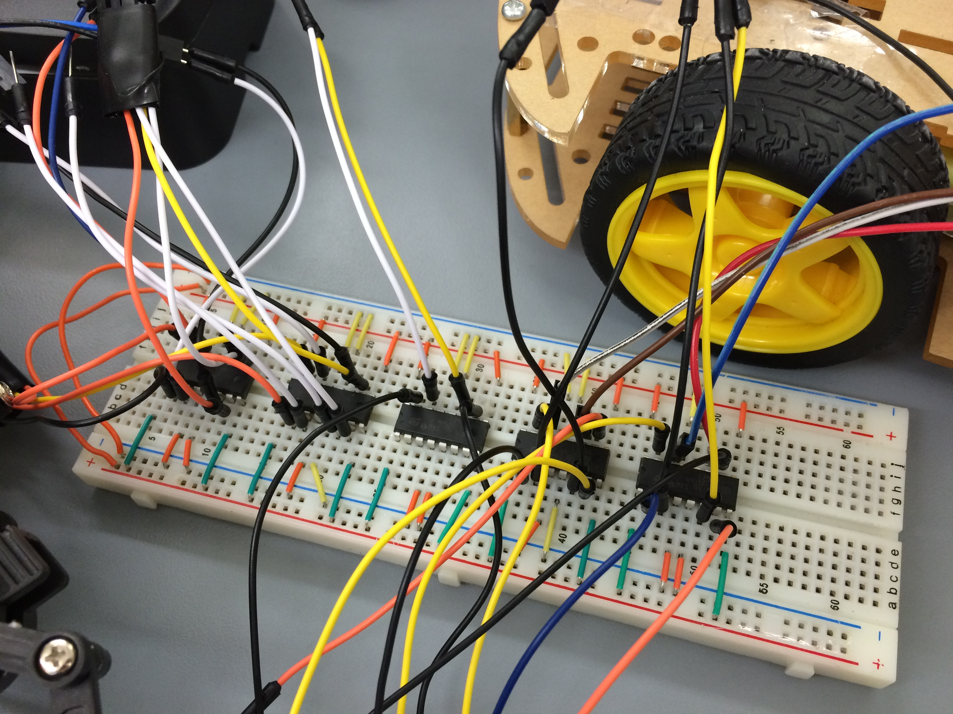
Actual Circuit

Slide 13
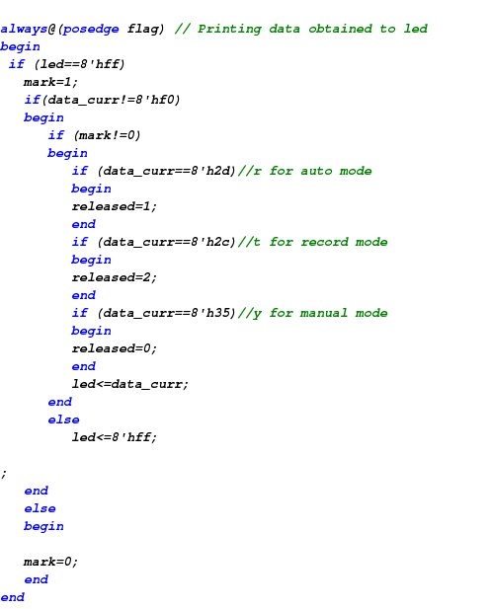
KeyBoard controller code example
By adding a flag to keyboard controller, we can send data to motor controller by keeping pressing a key(for manual mode) or pressing a key once(for auto mode).
mark=1 means last key is released and reset data to 8h’ff to receive new input key.
mark= 0 means the key is still being pressed and output data cannot be changed.

Slide 14
Successes
Competed modules:
Keyboard controller
Motor controller
Three operation modes
Driver circuit
Obstacles breakthrough
Keyboard supports two input method(keep pressing and press once)
Change relay to L293D chip to allow motors to move in opposite direction.

Slide 15
Failures
Two or more keys are pressed
Solved: The signal could be sent and can control motors properly.
Failure: The signal can’t be reset (back to 8’hff) when the keys are not released in a proper order. And need press any other key to stop motors.
Tradeoff: Design some keys to drive multi-motors.(Up-right, Down-left,e.g)
2. Motor's are not very precisely
Robotic arms cannot move back to its previous position exactly in auto mode.
Possible solution: Step motor.

Slide 16
Future Work
Optimizing code to record longer time (Memory is 20s now).
Using portable FGPA board instead of lab board.
Planting all things on kart, rerouting wires, allocating weight to make kart stable

Slide 17
Demo

